Slide 1
A
E
T
T
A
A
E
T
T
A
Sorn Chottananurak
Mentored by Taeckyung Lee, Sung-Ju Lee
Notes:
Hi, I'm Sorn. Today, I'll present my URP project, AETTA:

Slide 2
A
E
T
T
A
ccuracy stimation for
est- ime daptation
Label-Free
A
E
T
T
A
Sorn Chottananurak
Mentored by Taeckyung Lee, Sung-Ju Lee
Notes:
Label-Free Accuracy Estimation for Test-Time Adaptation, mentored by Taeckyung Lee and Professor Sung-Ju Lee.

Slide 3
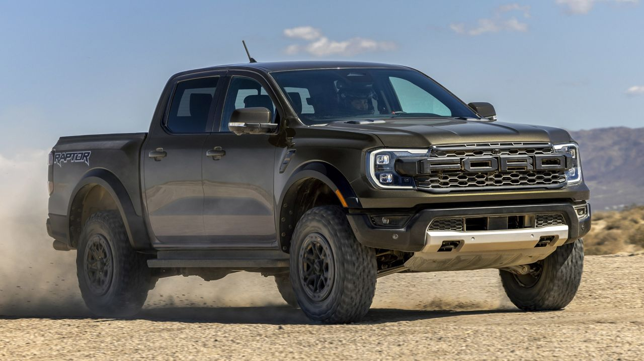
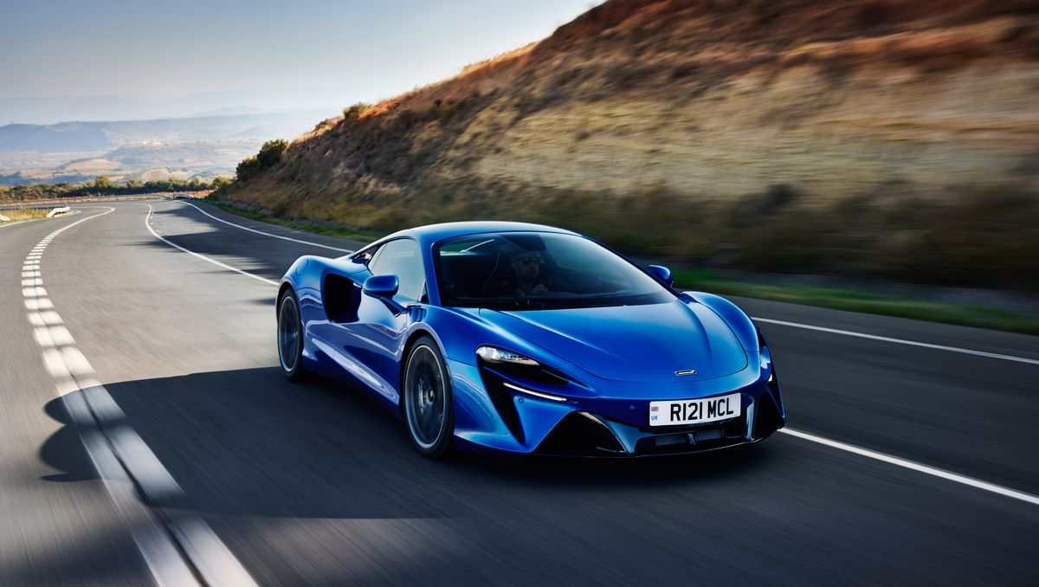
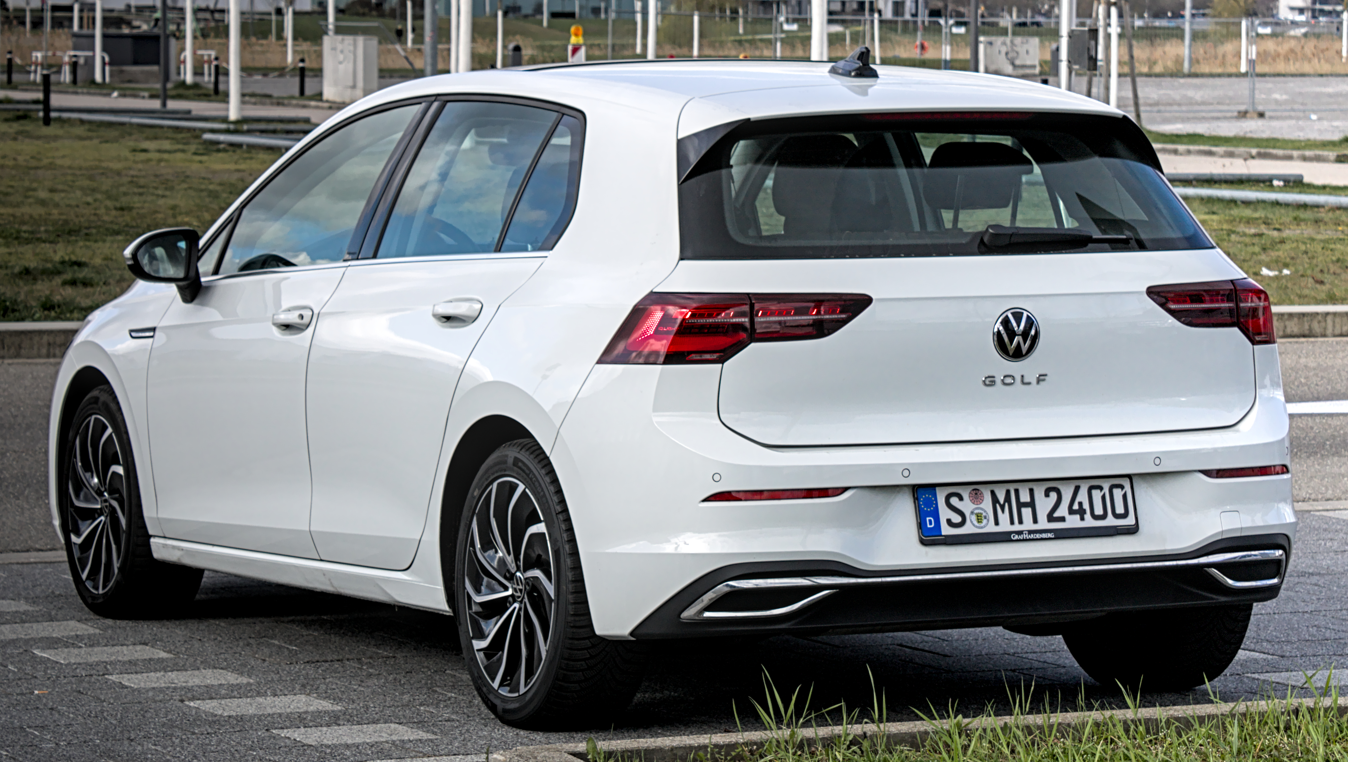





Introduction : Autonomous Driving Car
Model classifying car and road
Model
Car Images
Road Images
Training data
Let’s train our model with car and road images
Notes:
Before discussing the project, let's explore test-time adaptation using an example of an autonomous car. Imagine a simplified model that only classifies images as either car or road.

Slide 4

Introduction : Autonomous Driving Car
Model classifying car and road
Model
Car Images
Road Images
Training data
Let’s train our model with car and road images
Notes:
We start by gathering images of cars and roads to train the model.

Slide 5
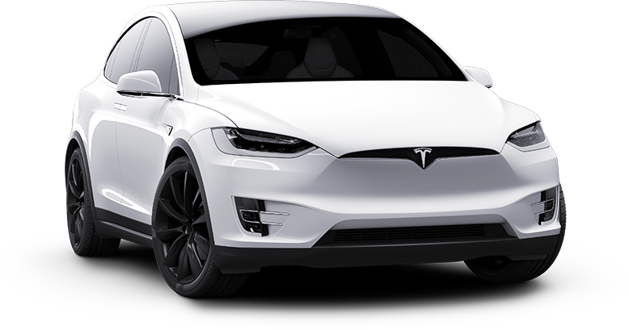
Introduction : Autonomous Driving Car
Model classifying car and road
Telsa with Auto-Pilot
Model
Notes:
Once trained, this model can be integrated into the autonomous driving system.

Slide 6
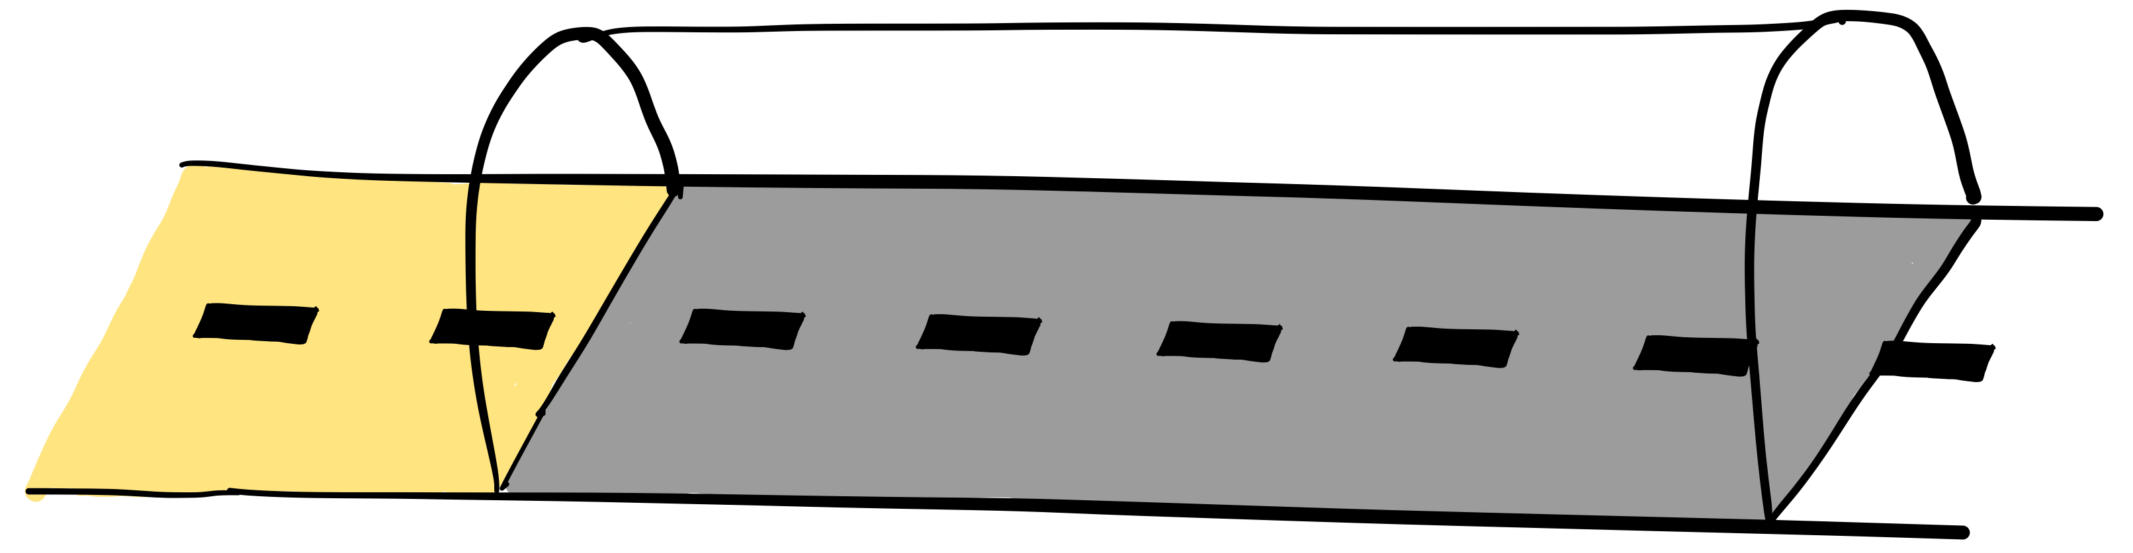


Introduction : Distribution Shift
Model performs well under normal condition
Model
Accuracy 90%
Notes:
When we deployed the car in real world, the model performs well under normal conditions.

Slide 7



Introduction : Distribution Shift
Model fails under unexpected environments
Model
Now, the model is trained
Accuracy 40%
Notes:
However, real-world environments often differ from training data. For instance, when the car enters a tunnel, the darker input images can degrade model performance, causing confusion between car and road, which may lead to serious accidents.

Slide 8
Solution : Test-Time Adaptation (TTA)
Attach the model with TTA at test-time
Model
TTA
Now, the model is trained
Accuracy 90%
Notes:
Researchers have proposed various solutions, including Test-Time Adaptation or (TTA). TTA is an algorithm that can be integrated into the model during test-time.

Slide 9
Solution : Test-Time Adaptation (TTA)
TTA adapts model to unlabeled test samples
Model
TTA
Now, the model is trained
Accuracy 85%
Notes:
This algorithm trains the model on incoming test images to help it adapt to the current environment.

Slide 10
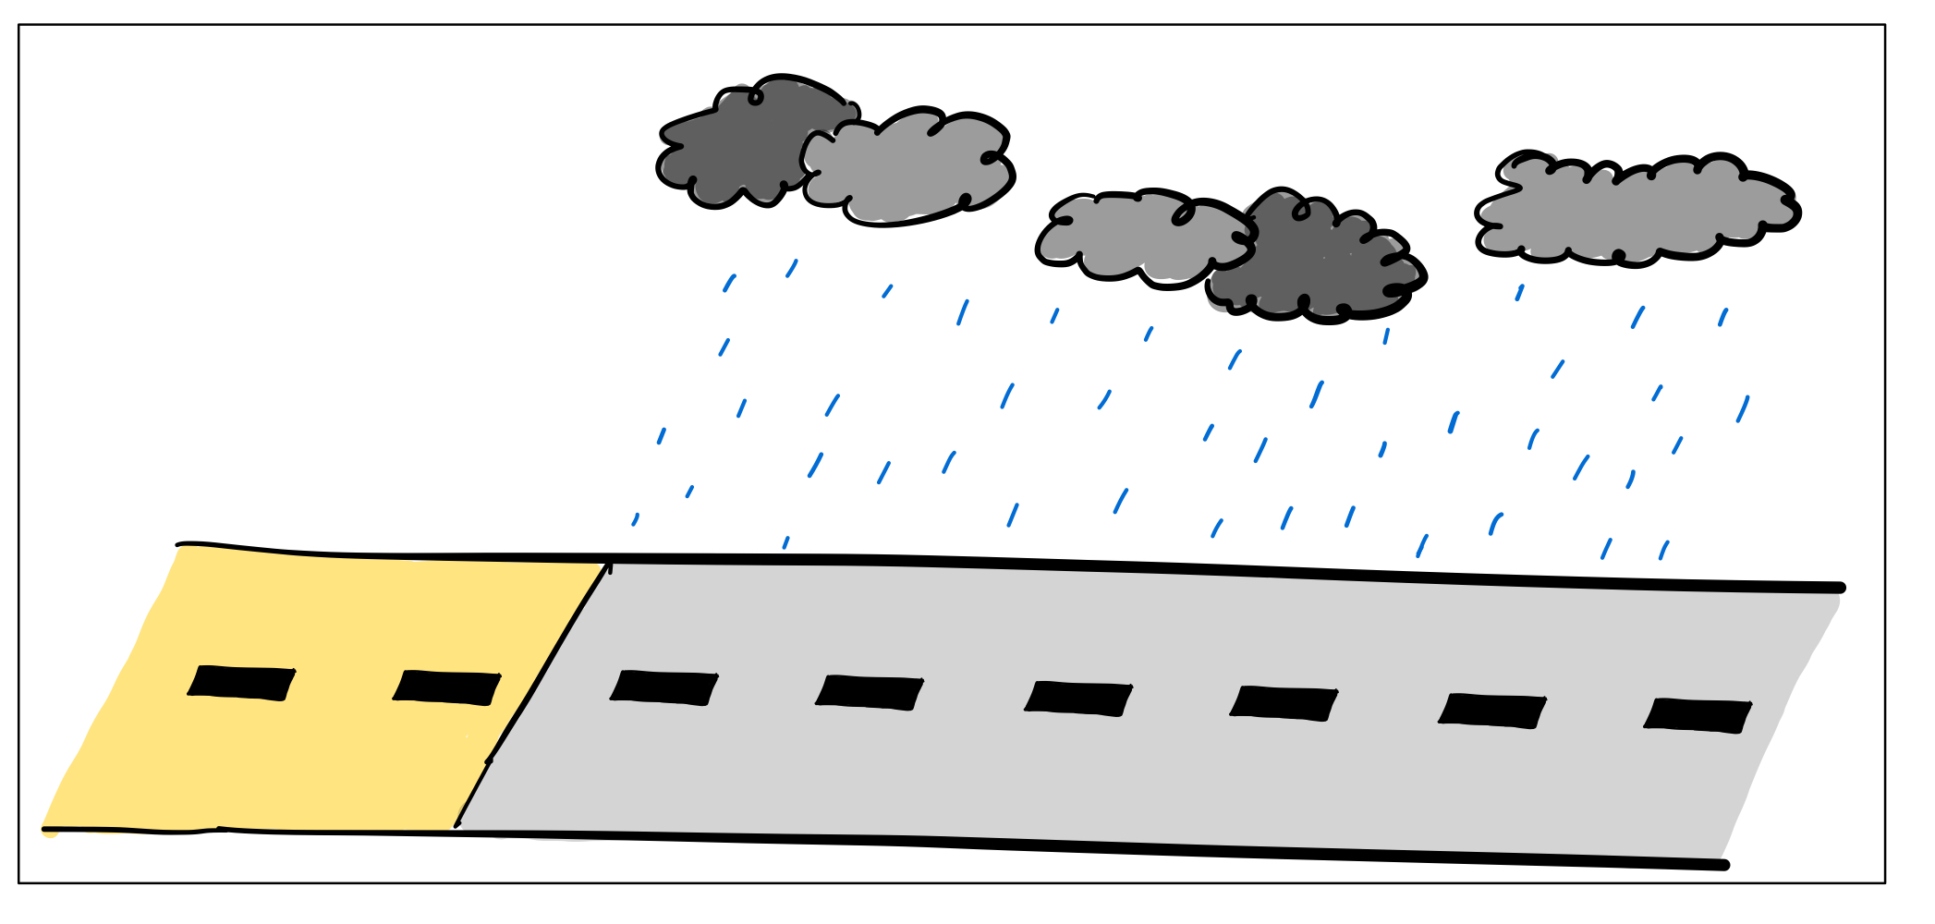
Solution : Test-Time Adaptation (TTA)
TTA is independent of the type of domain shift
Model
TTA
Accuracy 90%
Notes:
TTA is independent of the type of domain shift, allowing the model to adapt to any environment.

Slide 11

Solution : Test-Time Adaptation (TTA)
TTA is independent of the type of domain shift
Model
TTA
Accuracy 92%
Notes:
For instance, even in different conditions, like in the rain, TTA model still performs well.

Slide 12
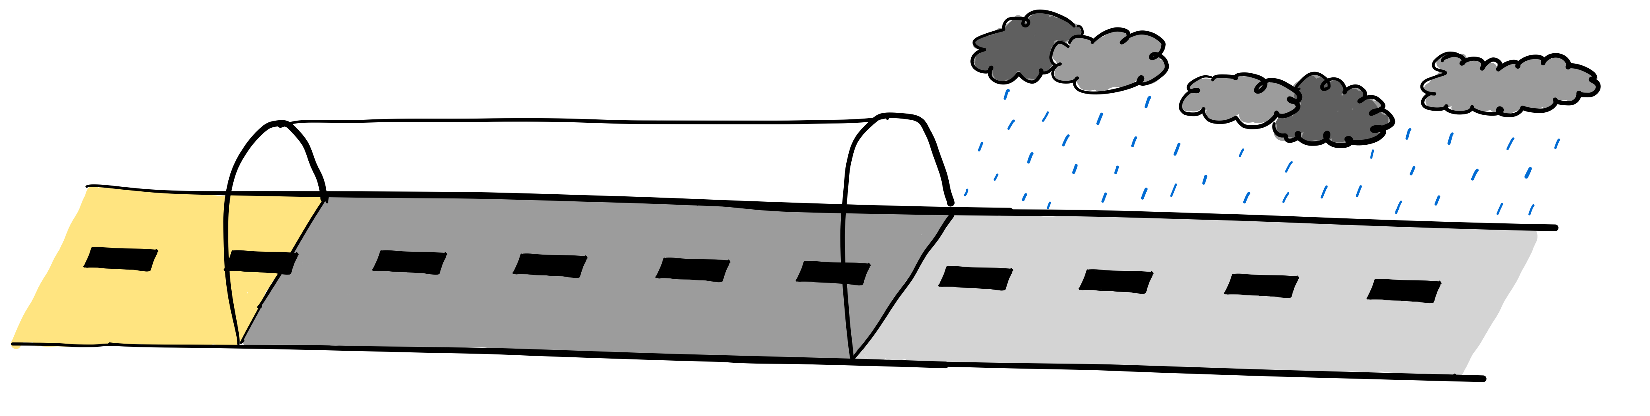
Problem of TTAs : Continual Domain Shift
Some TTAs fail in continually changing environment
Model
TTA
Accuracy 90%
Notes:
However, some TTAs struggle with environments that continually change over time,

Slide 13
Problem of TTAs : Continual Domain Shift
Some TTAs fail in continually changing environment
Model
TTA
Accuracy 85%
Notes:
such as transitioning from normal weather to a tunnel and then to rain.

Slide 14
Problem of TTAs : Continual Domain Shift
Some TTAs fail in continually changing environment
Model
TTA
TTA is not practical
Accuracy 28%
Notes:
In this case, TTAs struggle to adapt, leading to lower accuracy.
This makes TTA not entirely practical in real world applications.

Slide 15


How to make TTA practical in real world?
Warning message to users “when accuracy is low”
Model
TTA
Warning Message
The model’s accuracy is very low. Please drive manually
System
Accuracy 28%
Notes:
One way to make TTA more practical in real world is that system needs to take a proper action when TTA model has low accuracy.
For example, the system should warn the user, so the user can manually drive in the current environment.

Slide 16

How to make TTA practical in real world?
accuracy
Reset model “when is low”
Reset!
Model
TTA
The model’s accuracy is very low.
I will reset the model now!
System
Accuracy 92%
Notes:
Or, system must reset the model to the original parameters to improve accuracy.

Slide 17
How to make TTA practical in real world?
Reset!
Model
TTA
accuracy
Warning message to users “when is low”
accuracy
Reset model “when is low”
The model’s accuracy is very low.
I will reset the model now!
System
Accuracy 92%
Notes:
Unfortunately, all these actions are not possible

Slide 18

accuracy
accuracy
Model
TTA
is NOT available in Test-Time
Accuracy 90%
Accuracy 85%
Accuracy 28%
Notes:
because these accuracies aren't available at test-time
Therefore, our main goal is to estimate model accuracy during deployment, so the system can handle TTA's unstable performance properly.

Slide 19
Research Problem
Accuracy Estimation for Test-Time Adaptation
Model
TTA
Can we estimate TTA model’s accuracy
with 0 labeled data?
Accuracy 90%
Accuracy 85%
Accuracy 28%
Notes:
This becomes our research problem, whether it's possible to estimate a model's accuracy under current distribution shift with zero labeled data.

Slide 20
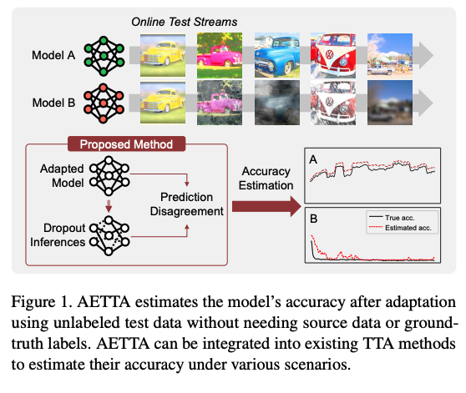
Proposed Method : AETTA
Label-Free Accuracy Estimation for Test-Time Adaptation
Notes:
We proposed AETTA , label-free accuracy estimation for test-time adaptation.

Slide 21
Proposed Method : AETTA
ML Model is represented as Neural Network
Telsa with Auto-Pilot
Model
Notes:
Before discussing methodology, let me introduce Monte Carlo dropout.

Slide 22
Proposed Method : AETTA
ML Model is represented as Neural Network
Car
Machine Learning
Model
Notes:
In machine learning, a model is often represented by a neural network where the connected line represented the learned knowledge.

Slide 23
Proposed Method : AETTA
Monte-Carlo Dropout removes knowledge from model
Monte-Carlo Dropout (MC-Dropout)
“Randomly remove some knowledge of learned model”
Sub-model
Notes:
Monte Carlo dropout involves randomly removing some of these connections, meaning we remove some of the knowledge from the model. I will call this modified model as the "submodel."

Slide 24
Proposed Method : AETTA
Prediction Agreement infers confidence of the model
Car
Test Sample
Monte-Carlo Dropout
Same!
That means model is confident about its prediction!
Car
Notes:
We try giving the same test sample to both the original model and the sub-model. If the predictions from both models are the same, it means the original model is confident in its prediction, because even we remove some knowledge from the model, it still sticks with the orignal prediction.

Slide 25
Proposed Method : AETTA
Prediction Agreement infers confidence of the model
Car
Test Sample
Monte-Carlo Dropout
Different!
That means model is
NOT confident about its prediction!
Tree
Notes:
On the other hand, if the predictions are not the same, it indicates that the original model is not very confident in its prediction.

Slide 26
Proposed Method : AETTA
Estimate Accuracy using Dropout Agreement
Model is confident on its prediction
We guess that its predict correct!
Count prediction agreement
with original model
MC-dropout
Prediction
Model is NOT confident on its prediction
We guess that its predict wrong!
Notes:
With this intuition, we developed our algorithm for estimating accuracy.
First, we perform MC-dropout predictions and count the agreement with the original model. If the agreement is high, the model is confident in its prediction, and we estimate it as correct. Conversely, if the agreement is low, the model lacks confidence, and we estimate the prediction as incorrect.

Slide 27
Proposed Method : AETTA
Estimate Accuracy using Dropout Agreement
Model is confident on its prediction
We guess that its predict correct!
Count prediction agreement
with original model
MC-dropout
Prediction
Model is NOT confident on its prediction
We guess that its predict wrong!
Under assumption that
“model is confident = model predicts correctly”
Notes:
However, this way of estimating accuracy will be true only if high confidence consistently means correct prediction.

Slide 28
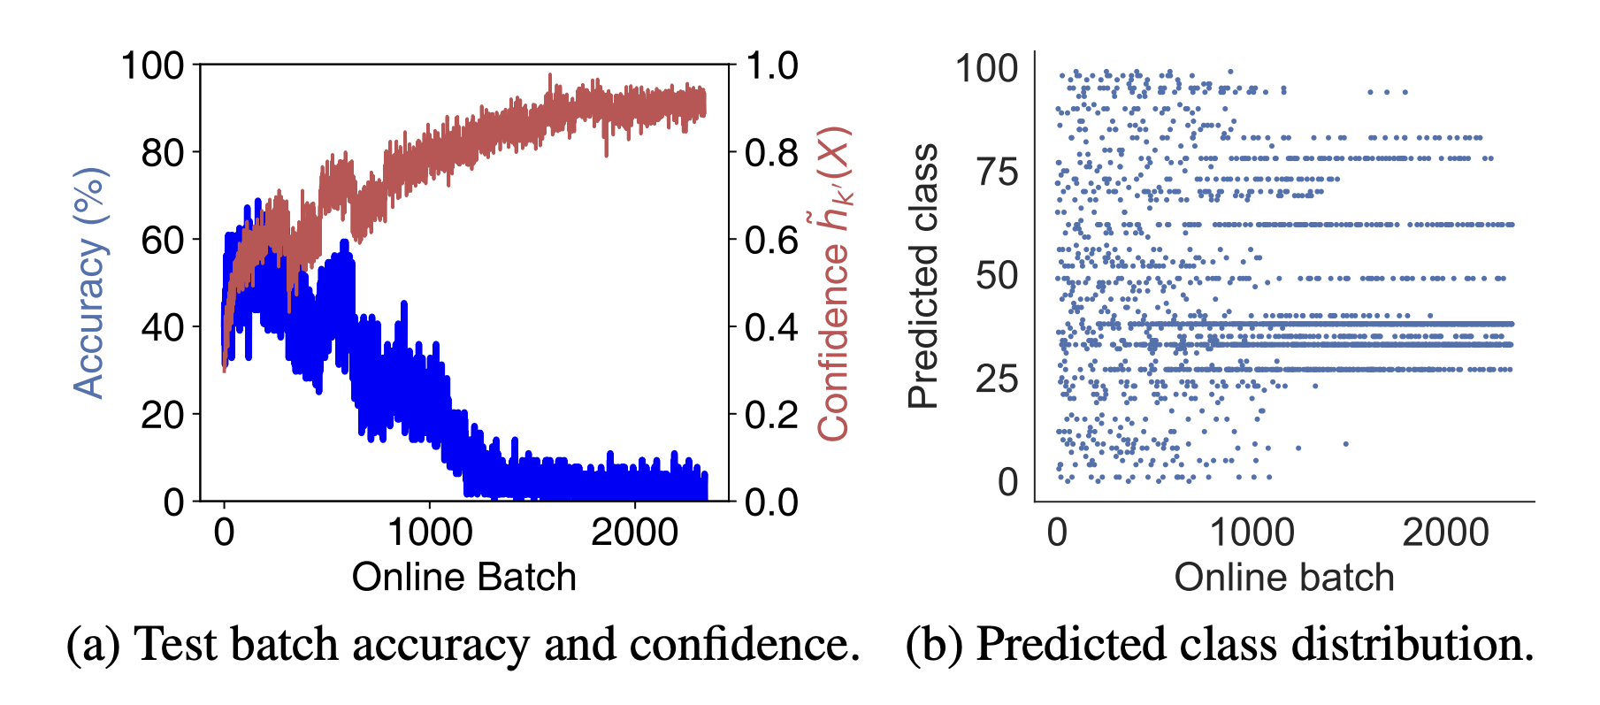
Proposed Method : AETTA
Over-confidence problem in TTA
Notes:
Unfortunately, this assumption does not hold in the TTA scenario.
As shown in the graph, while the model’s confidence increases over time, the accuracy degrades. This is a common issue with TTA, where the model becomes over-confident in its predictions.

Slide 29
Proposed Method : AETTA
Over-confidence leads to high class-skewness
Notes:
Fortunately, we identified a common characteristic of TTA.
When the model becomes over-confident, it tends to predict only a few classes.

Slide 30
Proposed Method : AETTA
Apply class-skewness as confidence calibration
Model is confident on its prediction
We guess that its predict correct!
Count prediction agreement
with original model
MC-dropout
Prediction
Model is NOT confident on its prediction
We guess that its predict wrong!
Under assumption that
“model is confident = model predicts correctly”
Notes:
With this idea, we can use class skewness in the TTA model to calibrate its confidence.
Based on the original accuracy estimation pipeline,

Slide 31
Proposed Method : AETTA
Apply class-skewness as confidence calibration
Model is confident on its prediction
We guess that its predict correct!
Count prediction agreement
with original model
MC-dropout
Prediction
Model is NOT confident on its prediction
We guess that its predict wrong!
Penalize the number based on
class-skewness
Under assumption that
“model is confident = model predicts correctly”
Notes:
we can add a component to penalize prediction agreement based on class skewness to make it align with the model's actual confidence level.
We call our accuracy estimation algorithm AETTA.

Slide 32
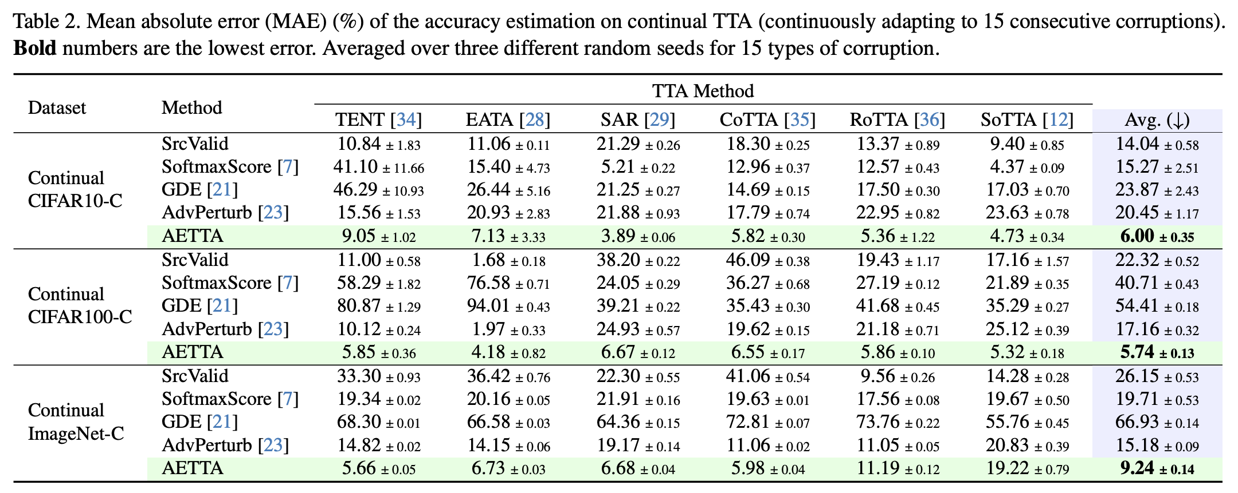
Experiment Results
AETTA outperforms all baselines in all scenarios
Notes:
We tested AETTA on 6 TTAs and 3 datasets, comparing it with 4 baselines. As shown in the table, AETTA outperformed all baselines in every scenario and becomes state of the arts accuracy estimation algorithm for test-time adaptation.

Slide 33
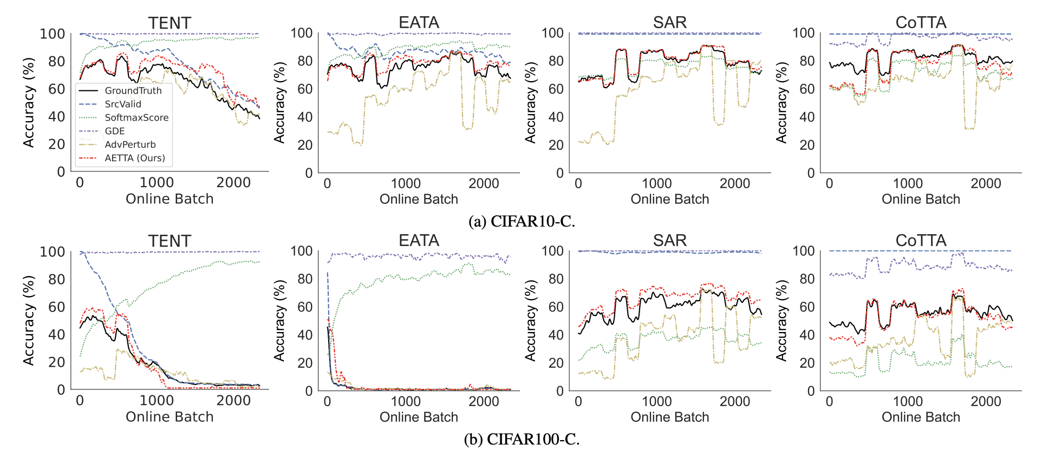
Experiment Results
Qualitative Analysis of AETTA
Notes:
The graphs show a qualitative analysis of AETTA
The black line represents ground truth accuracy, while the red line shows AETTA estimated accuracy, which closely follows the ground truth.

Slide 34
Case study
Deploy AETTA in real world
Model
TTA
AETTA
Est Acc. 88%
Accuracy 90%
Notes:
AETTA can be simply attached to existing TTA in test-time.

Slide 35
Case study
Deploy AETTA in real world
Model
TTA
AETTA
Est Acc. 82%
Accuracy 85%
Notes:
AETTA can estimate accuracy at test time without needing any labeled data.

Slide 36
Case study
Model Recovery with AETTA
Model
TTA
AETTA
Est Acc. 29%
Accuracy 28%
Notes:
To demonstrate AETTA's real-world application, we conducted an experiment on model recovery.
With access to estimated accuracy from AETTA, we can reset the model when the accuracy falls below a certain threshold.

Slide 37
Case study
Model Recovery with AETTA
Reset!
Model
TTA
AETTA
Est Acc. 89%
The model’s accuracy is very low.
I will reset the model now!
System
Accuracy 92%
Notes:
This significantly increases model accuracy and helps prevent model failure at test time.

Slide 38
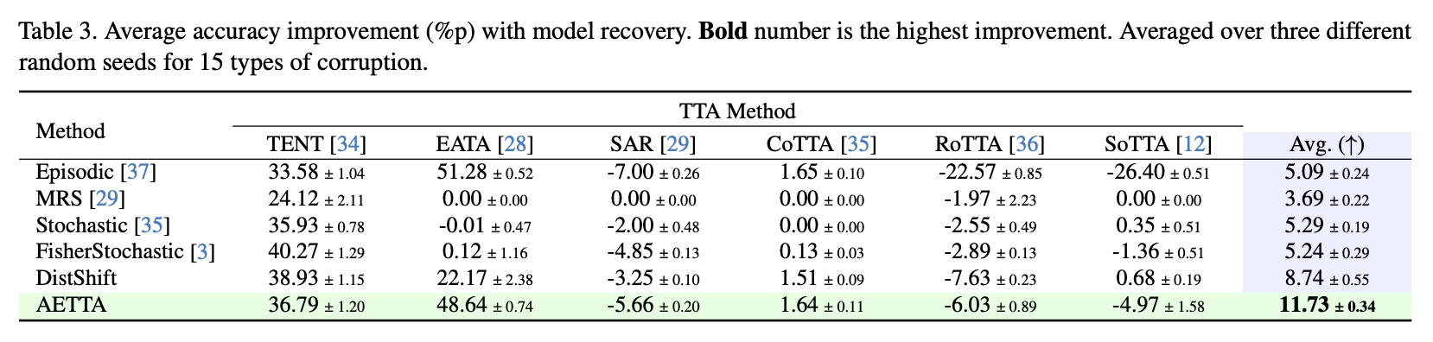
Case study : Experiment and Result
AETTA-based model recovery outperforms all baselines
Notes:
We tested our resetting algorithm on 6 TTAs against 5 baselines.
Our resetting method, based on AETTA estimated accuracy, showed the largest improvement, establishing it as the state-of-the-art in model recovery.

Slide 39
Contributions
AETTA-based model recovery outperforms all baselines
Topic | Sorn | Mentors (Taeckyung Lee, Sun-Ju Lee)
Idea development | 30-40% | 60-70%
Implementation and conducting experiments | 50-60% | 40-50%
Paper Writing | 5-10% | 90-95%
Notes:
Here's an overview of my contributions: I contributed 30-40% to idea development and was the primary contributor to implementation and running experiments. Since our project is published in CVPR, I helped the team write 5-10% of the paper, mainly focusing on the model recovery section.

